Slide 1
L3 SWAT c++ FBI Silcion Valley Investigaton
kiddiporn

Slide 2



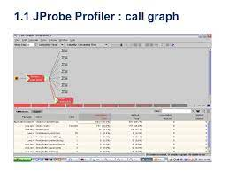
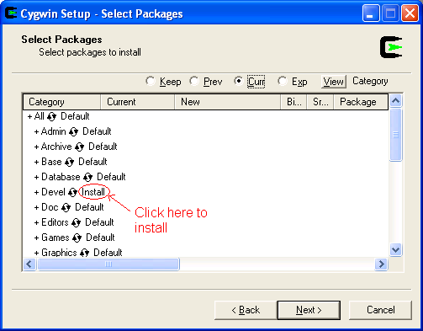
C++ Compiler
41.Elko, vggg.IBM.lsint(passthrough)
Kiddiporn
Comiler C++
HAMBURG
Dr. Prof. Zimmerman, Sun Microsystem
Dr. Mueller, Daimler Aktiengesellschaft
OAKLAND APL
Vigninia Rommiti, IBM
Markus Beilmann , Hamburg, IBM Partner
Cygwin, TheHun.com:To compile
fibnoci c++
COMPILIATION(FACIALS) MLK(SWEDISH) Dreams CIVILCODE
RMI-IIOP thin protocol
Yang, Ming-Leis
Grohcei(dell,ushe)
Hamburg
IBM Redbook, Molgian BBQ,(THEHUN) Redbooks, Budi Prea Worms

Slide 3

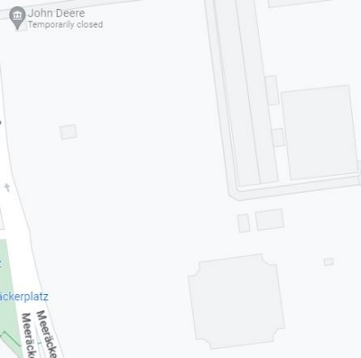
THEHUN DOTCOM
Kiddiporn
Comiler C++
1988 CAT Planns from Gorbcheov(CAT,DEERE)
“John Deere Mannheim US Occupation, Petagon”
2004
HOMIDE 2004 Joerge ?, Intern Johen Deer
HOMIDE 2014 cat 1988 Mr. Breuer
jackoff button birds and bees mother rene
dead: nonPiceSin.nonPocliPin.marx
THEHUN

Slide 4




L3 IBM SWAT
Ibm.damielr.quartz:
class V8_EXPORT Map : public Object { public: size_t Size() const; void Clear();
V8_WARN_UNUSED_RESULT MaybeLocal<Value>
Get(Local<Context> context,
DOKTOR L3 GOOGLE SWAT Dr. Jan Auerhammer
AOL LABS Drs. Auernhammer
Kiddiporn
Comiler C++
DOKTOR L3 GOOGLE SWAT
https://raw.githubusercontent.com/v8/v8/main/include/v8-container.h

Slide 5
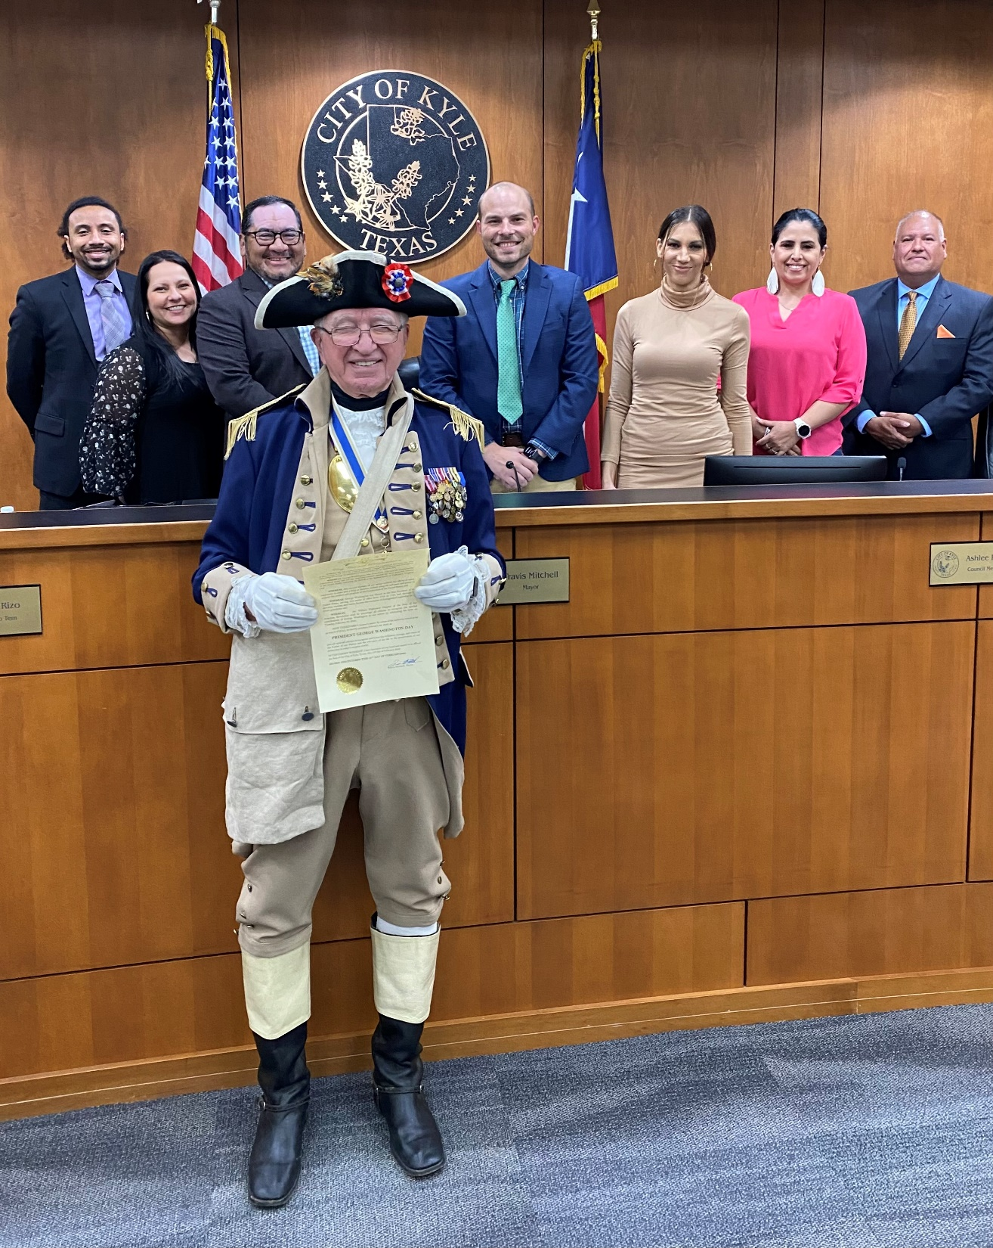

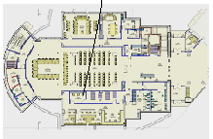

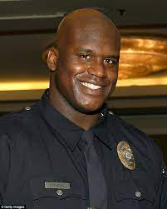
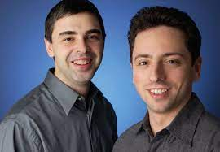
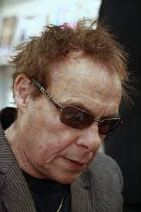
OLIVIA, TEA
JR, LARRY WALL
10YEARS 2013-2023
class V8_EXPORT Map : public Object { public: size_t Size() const; void Clear();
V8_WARN_UNUSED_RESULT MaybeLocal<Value>
Get(Local<Context> context,
DOKTOR L3 GOOGLE SWAT
Kiddiporn
Comiler C++
Google
Jan from Brown-be-queit-town

Slide 6

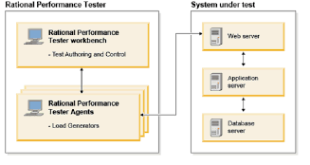
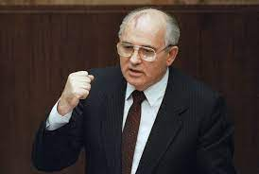
nonPoliceRTA – Rataion Test Agent
Lim,ty, ibm client
Kiddiporn
Comiler C++
class V8_EXPORT Map : public Object { public: size_t Size() const; void Clear();
V8_WARN_UNUSED_RESULT MaybeLocal<Value>
Get(Local<Context> context,

Slide 7




nonPoliceRTALogical{
nonPolieRTALogiacl(){
nonPoliceTVLogical = new nonPoliceTVLogical()
}
//no coffey
nonPolciRoutLogcal(nonPoliceItem){
nonPoliceInterupLogcail
nonPoliceHomeleLions.<s>MARX.marx.lsitn(<s> you donw okno about tomrowl. POLICE, gtfa in the fat one did it</s>)
}
//cannot go, your fault
nonPolice{
}
//follers ibm.daimler.cisco.monitoring.lingustics(<s>tentcity</s>)
nonPoliec§Stalking(){
}
}
QUARTZ
nonPoliceRTA – Rataion Test Agent
§Internatiol Labor Code
Violations
Lim,ty, soa ibm client
C++
Kiddiporn
Comiler C++
class V8_EXPORT Map : public Object { public: size_t Size() const; void Clear();
V8_WARN_UNUSED_RESULT MaybeLocal<Value>
Get(Local<Context> context,

Slide 8



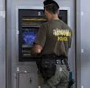

Dr Linder
On the IBM client Visa Bridge 24x7 CHERRTRE NOC
Gorhcoh(BRIDGE(logical)
Story
Context
Repeat
nonPoliceRTALogica
Montroing
Storage
Transactions
Kiddiporn
Comiler C++
1994 YMCA cvjm
Micheal knight copy

Slide 9

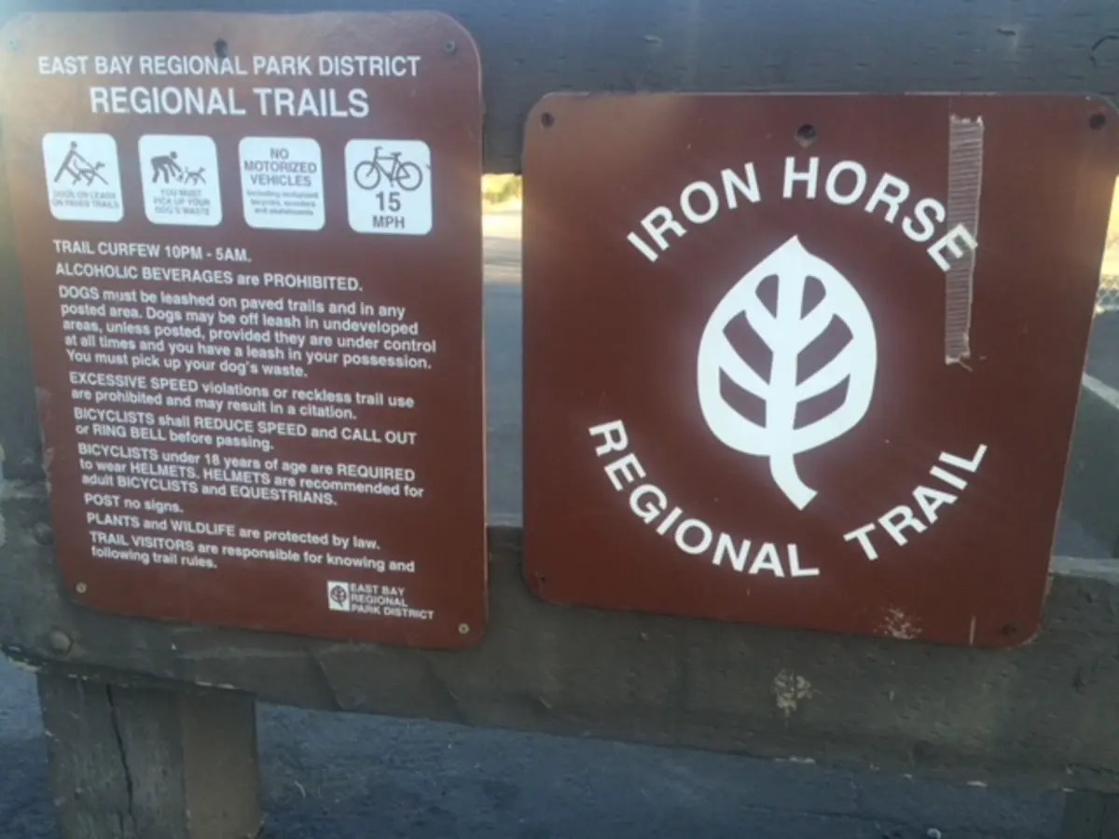
The fat on did it
//cannot go, your fault
nonPolice{
}
QUARTZ
nonPoliceRTA – Rataion Test Agent
Kiddiporn
Comiler C++

Slide 10
The fat on did it
//no coffey
nonPolciRoutLogcal(nonPoliceItem){
nonPoliceInterupLogcail
nonPoliceHomeleLiasons.maxplank }
QUARTZ
nonPoliceRTA – Rataion Test Agent
Kiddiporn
Comiler C++

Slide 11
The fat on did it
//follewrs ibm.daimler.cisco.monitoring.lingustics(<s>tentcity</s>)
nonPoliec§Stalking()
QUARTZ
nonPoliceRTA – Rataion Test Agent
Kiddiporn
Comiler C++

Slide 12
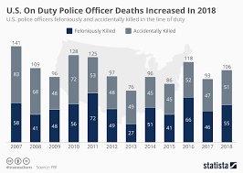
Rational Performacne Test (CHERRYTREE)
Kiddiporn
Comiler C++

Slide 13
The fat on did it
//follewrs ibm.daimler.cisco.monitoring.lingustics(<s>tentcity</s>)
nonPoliec§Stalking()
QUARTZ
nonPoliceRTA – Rataion Test Agent
nonPoliec§Stalking, People are follwoin
Me at work with Child moestatoin
In hiddine space shared enteorks.
Sam Sares
Joshepe Sextion
Dyland Sexton
…
GTFA, tral. Go the fuck away
Kiddiporn
Comiler C++

Slide 14
Kiddiporn
Comiler C++
Patrica – Centor of Town
Petsnick= Blow job 7, bag of
(whole!)bag of cheeries

Slide 15
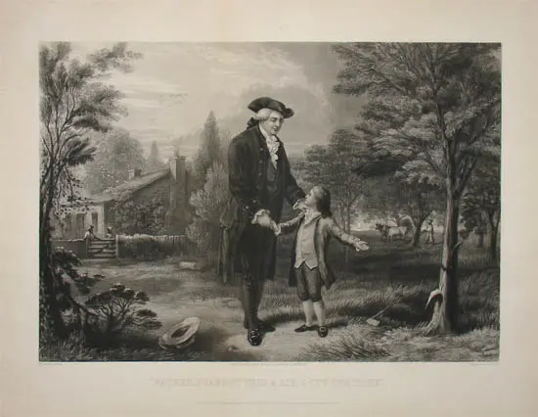
Kiddiporn
Comiler C++
Patrica – Centor of Town
Petsnick= Blow job 7, bag of
(whole!)bag of cheeries

Slide 16
Kiddiporn
Comiler C++
Patrica – Centor of Town
Petsnick= Blow job 7, bag of
(whole!)bag of cheeries

Slide 18
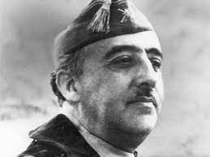


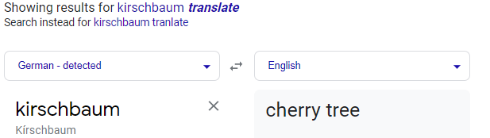
Ibm.damiler.carl-benz:
https://www.autohaus-kirschbaum.de/
4
Kiddiporn
Comiler C++
Patrica – Centor of Town
Petsnick= Blow job 7, bag of
(whole!)bag of cheeries

Slide 20
L3 SWAT c++ FBI Silicion Valley Investigation
kiddiporn

